Slide 1
Sachs Immuno-Oncology: BD&L and Investment Forum Pharma-Biotech BD&L Panel
Co-Chairs:
Mike Rice, Senior Consultant, Defined Health
Peter Hoang, Senior Vice President, Business Development & Strategy, Bellicum Pharmaceuticals
Panelists:
Ali Fattaey, President & CEO, Curis, Inc.
Guillaume Vignon, Director, Oncology Business Development, Global Licensing & Business Development, Merck Serono SA
Ioannis Sapountzis, Global Head, Oncology Business Development & Licensing, Boehringer Ingelheim GmbH
Jeffrey Bacha, President & CEO, Del Mar Pharmaceuticals
Ji Li, Vice President, Business Development & Licensing, Merck Research Laboratories
Peter Sandor, Vice President, Global Marketing Oncology, Amgen
John DeYoung, Vice President, Worldwide Business Development, Pfizer, Inc.
Reginald Seeto, Vice President, Head of Partnering & Strategy. MedImmune
Tanja Weber, Strategy & Business Development, Vice President, Oncology Corporate Licenses, Sanofi

Slide 2
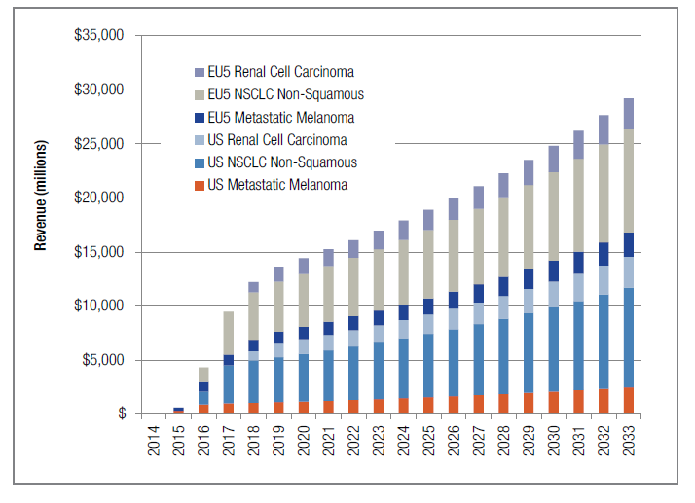
The I/O Space Is Hot, Really Hot…
Citibank; Triangle Insights Group; EvaluatePharma

Slide 3
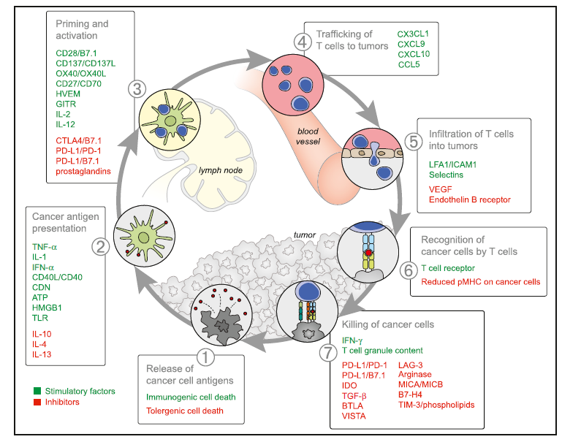
The Cancer Immunity Cycle Offers Multiple Points of Intervention
Abbreviations are as follows: IL, interleukin; TNF, tumor necrosis factor; IFN, interferon; CDN, cyclic dinucleotide; ATP, adenosine triphosphate; HMGB1, high-mobility group protein B1; TLR, Toll-like receptor; HVEM, herpes virus entry mediator; GITR, glucocorticoid-induced TNFR family-related gene; CTLA4, cytotoxic T-lympocyte antigen-4; PD-L1, programmed death-ligand 1; CXCL/CCL, chemokine motif ligands; LFA1, lymphocyte function-associated antigen-1; ICAM1, intracellular adhesion molecule 1; VEGF, vascular endothelial growth factor; IDO, indoleamine 2,3-dioxygenase; TGF, transforming growth factor; BTLA, B- and T-lymphocyte attenuator; VISTA, V-domain Ig suppressor of T cell activation; LAG-3, lymphocyte-activation gene 3 protein; MIC, MHC class I polypeptide-related sequence protein; TIM-3, T cell immunoglobulin domain and mucin domain-3. Although not illustrated, it is important to note that intratumoral T regulatory cells, macrophages, and myeloid-derived suppressor cells are key sources of many of these inhibitory factors.
Immunity 39, July 25, 2013

Slide 4
The I/O Toolkit Crosses All Components of the Immune System and Therapeutic Approaches from Small Molecules to Cell therapy
Cancer Immunotherapy
T-Cell Immunity
B-Cell Immunity
Innate Immunity
Cytokines
Adjuvants
T-cell Checkpoint Modulators
Checkpoint modulators
T-reg Therapies
T-Cell Redirecting mABs
Adoptive T-Cell Therapy
NK Cell Therapies
Oncolytic Viruses
Antigen Specific Cellular Immunotherapy
Notes:
Adoptive immunotherapy
Autologous activated T- lymphocytes
Genetically modified activated T-lymphocytes
Chimeric antigen receptor integrated T-lymphocytes
Activated dendritic cells
Genetically modified dendritic cells

Slide 5
Checkpoints Likely to Be Foundational
Anti-PD/L-1 agents will be similar to that of the taxanes being the foundational piece of immunotherapy regimens across tumor types and lines of therapy.
T-Cells
Vaccines
Oncolytic Viruses
Costim Agonists
(e.g. 4-1-BB agonist mAbs)
Checkpoint Blockade
(e.g. anti-PD/L1 mAbs)
Defined Health

Slide 6
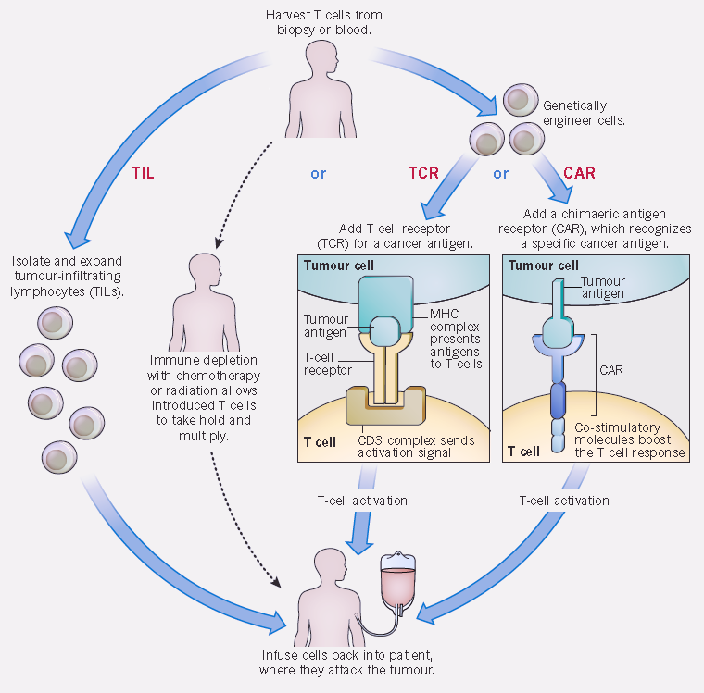
On the Heels of Checkpoints, 2015 is a Boom Year for Adoptive T-Cell Therapies
T-Cell Receptors
(TCRs)
Chimeric Antigen Receptors (CARs)
Tumor Infiltrating Lymphocytes (TILs)
http://www.intechopen.com/books/melanoma-in-the-clinic-diagnosis-management-and-complications-of-malignancy/adoptive-t-cell-therapy-of-melanoma-promises-and-challenges
Notes:
CELLULAR ATTACK Adoptive cell transfer (ACT) attacks cancer using either tumour-inltrating lymphocytes (TILs) or genetically engineered T cells. Engineered cells are given either a new T-cell receptor (TCR) or an antibody-like molecule called a chimaeric antigen receptor (CAR); both activate the T cell when they encounter a particular cancer antigen.

Slide 7
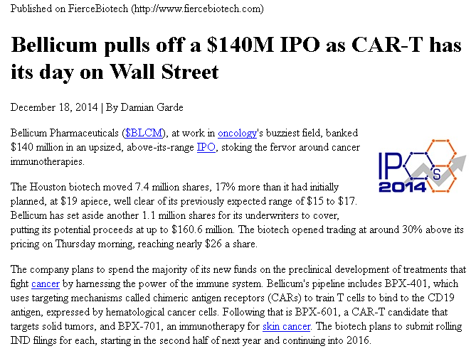
Clinical PoC Triggers Flurry of Investments into CAR-Ts
A growing number of biotechs are now well-financed to translate CAR-Ts into commercial products:
CAR-Ts: Juno Therapeutics, bluebird bio, Kite Pharma, Cellectis S.A., Bellicum, Cardio3 and Autolus
Pharma has entered the space, both through traditional risk-sharing partnerships with biotech (e.g. Pfizer-Cellectis) and direct academic collaborations (e.g. Novartis-UPenn, Amgen/Kite).
FierceBiotech, company press releases

Slide 8
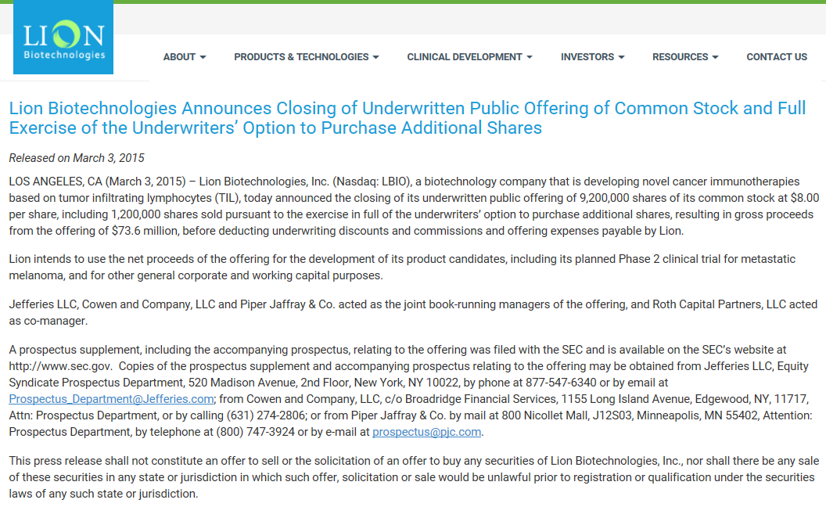
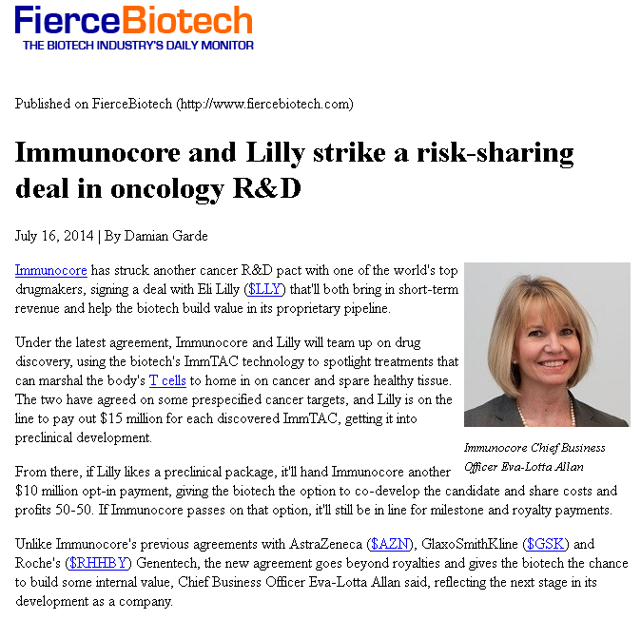
And Investments into Alternative T-Cell Approaches
TCR and non-cell based monoclonal TCRs: Adaptimmune, Immunocore and Medigene
TILs (Lion Biotechnologies) and universal donor T-cells (Atara).
FierceBiotech, company press releases, company websites

Slide 9
Cell Therapy Innovators Have Access To Capital for Go To Market Strategy
Bloomberg.com

Slide 10
Amgen’s T-Vec: First Oncolytic Virus Immunotherapy Nears Approval
FDA Panel Gives a Thumbs Up to Amgen's T-Vec For Melanoma
April 29, 2015
Amgen's regulatory team for talimogene laherparepvec (T-Vec) was grilled by a group of outside FDA experts who picked up on some major questions regarding the Phase III melanoma study that was used to back its new drug application. A vigorous defense of the drug, though, helped make a winning case for the therapy, which was ultimately supported by all but one member of the panel.
There was considerable sentiment in favor of restricting the drug to certain patient groups, with some of the panelists expressing their frustration that they couldn't register a vote regarding the low likelihood that the drug would work for visceral (internal) tumors or later-stage patients.
At the end of the day, though, the expanded panel voted 22 to 1 that the drug has a favorable risk/benefit profile. T-Vec is injected directly into tumors, where it replicates and then ideally ruptures the tumor cells. The rupture causes the release of antigens which in turn spur the immune system response--a kind of one-two punch that represents a different approach to treating melanoma.
"There are clearly patients in my clinic I'd like to use this for," noted Patrick Hwu, a professor in the department of Melanoma Medical Oncology at the University of Texas MD Anderson Cancer Center who voted to support T-Vec. A number of the experts noted that the more "arrows" they had in their therapeutic quiver, the better off patients would be. The final decision is being left in the hands of the FDA, though today's vote would make T-Vec an odds-on favorite for approval. If so, Amgen ($AMGN) is on track to score several possible approvals this year, marking some advances after analysts like Geoffrey Porges have criticized the Big Biotech's development strategy and heavy research costs. The day started with FDA reviewers offering some skeptical remarks about their interpretation of the late-stage data. "The evidence that talimogene has a systemic effect was limited and difficult to calculate," FDA reviewer Robert Le told the committee. In particular, committee members noted that there were widely different response rates among different subgroups in the study. For Le, "first line or less advanced patients may have responded better.” “Subjects with small lesions may be more likely to respond," he added, "larger lesions less likely.” […]
http://www.fiercebiotech.com/story/fda-panel-gives-amgen-thumbs-t-vec-melanoma/2015-04-29

Slide 11
Vaccines Comprise the Largest Component of the Cancer Immunotherapy Pipeline
Adis R&D Insight, Thomson Reuters Cortellis

Slide 12
Most Large Pharmaceuticals Have at Least Two Platforms of Clinical Stage Immuno-Oncology Assets
More than half of pharmaceutical companies evaluated have at least two categories of clinical stage assets (highest stage asset indicated).
BMS, Merck and Amgen are the only companies with marketed immuno-oncology assets in the US market.
Clinical Stage I/O Assets | NVS | Roche | Lilly | AZ | GSK | CELG | AMGN | BMS | Sanofi | Merck | Pfizer | J&J | Merck KGaA
Checkpoint/ Costims |  | III | II | III | I |  |  | M |  | M | III | III | II
Oncolytic Viruses |  |  |  |  |  |  | PreReg
Vaccines |  |  |  |  | III* | II |  |  |  | I |  | I | II
Adoptive Cell Therapy | II |  |  |  |  | Pre |  |  |  |  | Pre
Cytokines |  |  |  |  | I |  |  | I
TCR/BiTes |  |  | I | I | I/II |  | M |  | I **
Other Immunomod |  | I | II |  |  | II
Adis Database, Defined Health; *Failed in lung (MAGE-A2); **CD20-CD3 entering clinic this year

Slide 13
Players Are Diversifying by Developing Multiple Immunomodulatory Antibodies & Solidifying Franchises Through Combinatorial Optionality
Large companies are rapidly moving into the checkpoint antagonist and costimulatory agonist space through partnering and acquisition.
BMS is well positioned to exploit the combinatorial options through its deep pipeline of antibodies.
Selected Antibody Targets: Checkpoints Antagonists and Costimulatory Agonists
Clinical Stage Checkpoints | NVS | Roche | Lilly | AZ | GSK | CELG | Amgen | BMS | Sanofi | Merck | Pfizer | J&J | Merck KGaA
CTLA-4 |  |  |  | III |  |  |  | M
PD1/PDL1/PDL-2 | Pre | III² |  | III² | I¹ |  |  | III^{1,2} |  | M¹ | III² |  | III²
4-1BB/CD137 |  |  |  |  |  |  |  | II |  |  | I
OX-40 |  |  |  | I/II
KIR |  |  |  |  |  |  |  | II
4-1BB/CD137 |  |  |  |  |  |  |  | II |  |  | I
LAG-3 |  |  |  |  |  |  |  | I
GITR |  |  |  |  |  |  |  |  |  | I
CXCR4 |  |  | II |  |  |  |  | I
Target is PD-1¹ or PD-L1²
Source: Adis R&D Insight, October 2014, Defined Health

Slide 14
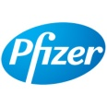
High Valuations Driven By Need For Access to Complementary I/O assets
Immuno-oncology Deal Timeline 2014-2015
Mar 2014
$350M
Checkpoints
June 2014
$265M
CAR-T
Sept 2014
Undisclosed
CART+ antibodies
Oct 2014
IDO/TDO inhibitor
$150M + $1B
May 2014
$365M
ADU741/GVAX
June 2014
$350M
NY-ESO-1
2014
Feb 2014
Undisclosed
M&A
July 2014
$25M
T-cell therapy
Nov 2014
$850M+ $2B
MSB0010718C
June 2014
Undisclosed checkpoints
July 2014
Undisclosed
checkpoints
Dec 2014
$11M
CAR-TNK
High Value or Big Pharma
IO Combinations
Sept 2014
$46.M + $572M
CV9202 + Chemo
IO + Traditional Therapeutics
EvaluatePharma, Company Website

Slide 15
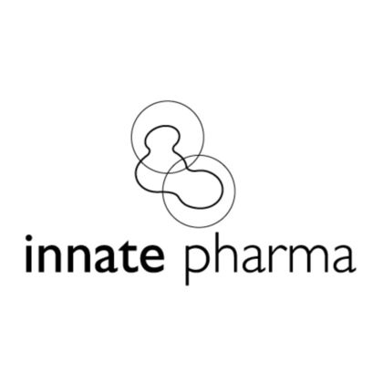
High Valuations Driven By Need For Access to Complementary I/O assets
Immuno-oncology Deal Timeline 2014-2015
Feb 2015
$339M
TGF-beta
Mar 2015
$975M
Prostvac
Mar 2015
$941M
CAR-T
Apr 2015
Undisclosed
CART/PDL1
Jan 2015
$625M
MGD011
Apr 2015
$555M + $530M
IDO + TDO
2015
Jan 2015
$525M
CAR-T
Mar 2015
Undisclosed
PD1 + GITR
Feb 2015
$339M
IDO1
Apr 2015
$350M + 925M
IPH2201
High Value or Big Pharma
IO Combinations
Feb 2014
Undisclosed
IDO1 + ADXS-HPV
Mar 2015
$250M
STING agonists
IO + Traditional Therapeutics
EvaluatePharma, Company Website

Slide 16
Sachs Immuno-Oncology: BD&L and Investment Forum Pharma-Biotech BD&L Panel
Co-Chairs:
Mike Rice, Senior Consultant, Defined Health
Peter Hoang, Senior Vice President, Business Development & Strategy, Bellicum Pharmaceuticals
Panelists:
Ali Fattaey, President & CEO, Curis, Inc.
Guillaume Vignon, Director, Oncology Business Development, Global Licensing & Business Development, Merck Serono SA
Ioannis Sapountzis, Global Head, Oncology Business Development & Licensing, Boehringer Ingelheim GmbH
Jeffrey Bacha, President & CEO, Del Mar Pharmaceuticals
Ji Li, Vice President, Business Development & Licensing, Merck Research Laboratories
Peter Sandor, Vice President, Global Marketing Oncology, Amgen
John DeYoung, Vice President, Worldwide Business Development, Pfizer, Inc.
Reginald Seeto, Vice President, Head of Partnering & Strategy. MedImmune
Tanja Weber, Strategy & Business Development, Vice President, Oncology Corporate Licenses, Sanofi

